Slide 1

Senior Design Project Presentation on WIRELESS POWER TRANSFER FOR CHARGING OF ELECTRIC VEHICLES
Presented by
Ms. SHUBHANI ARUNASHREE
Reg No:1941016019
Mr. SNEHASHIS SUBUDHI RATNA
Reg No:1941016051
Supervisor
Prof. SABITA MALI
Department of Electronics & Communication Engineering
Institute of Technical Education & Research (FET)
Siksha ‘O’ Anusandhan Deemed to be University, Bhubaneswar
June, 2023

Slide 2
Contents
Introduction
Literature Survey
Design Scheme
Testing, Analysis, And Evaluation
Socio-economic Issues Associated With The Project
Engineering Tools And Standards
Conclusion

Slide 3
Introduction
Eco-friendly vehicle is the global trend in the automobile industry. It is the most suitable alternative of petroleum vehicles.
Electric Vehicles charging process and travelling range has become a major issue which is affecting it’s adoption over petrol or diesel vehicles.
To solve these problems, wireless charging of electric vehicle is introduced.
It reduces the time spent on recharging or even allows the EV to get charged during its movement.
The daily travel expenses of individuals can be less with using electric vehicles.

Slide 4
Literature Survey
Sl No. | Author | Techniques | Work details
1. | Taylor M.Fisher, Yabiao Gao [1] | Wireless Power Transfer | Wireless charging (WC) technology operates on the principles of magnetic inductance and magnetic resonance. A magnetic field is induced in the surrounding area by running currents through a coil of wire. Exposing another coil nearby to that magnetic field will induce an electric current in the nearby coil; thus, wireless power transfer (WPT) is achieved.
2. | Muhammad Amzad,Farooq-i-Azam [2] | Types of EV Wireless Charging Technology | Static charging is a stationary wireless charging method, where the vehicle charges under standstill conditions. In Dynamic charging method, a stationary transmitter transmits power over the air to the receiver coil in a moving vehicle.

Slide 5
Literature Survey
Sl No. | Author | Techniques | Work details
3. | Yong Li, Jiefeng Hu [3] | Types of Dynamic charging for EV | Wireless Capacitive Electric Vehicle Charging System. Permanent Magnetic Gear Wireless Electric Vehicle Charging System. The Inductive Wireless Electric Vehicle Charging System. Resonant induction Electric Vehicle Charging System.
4. | Alhamroun,Ibrahim [4] | Inductive wireless charging | The basic principle of inductive wireless charging(IWC) is Faraday's law of induction. The wireless transmission of power is achieved by mutual induction of magnetic field between transmitter and receiver coil.

Slide 6
Literature Survey
Sl No. | Author | Techniques | Work details
5. | Musavi, Fariborz, Murray Edington [5] | Working principle used for power transfer | When the main AC supply applied to the transmitter coil, it creates AC magnetic field that passes through receiver coil and this magnetic field moves electrons in receiver coil causes AC power output. This AC output is rectified and filtered to Charge the EV’s energy storage system. The amount of power transferred depends on frequency, mutual inductance and distance between transmitter and receiver coil. Operating frequency of inductive wireless charging is between 19 to 50 KHz [6].

Slide 7
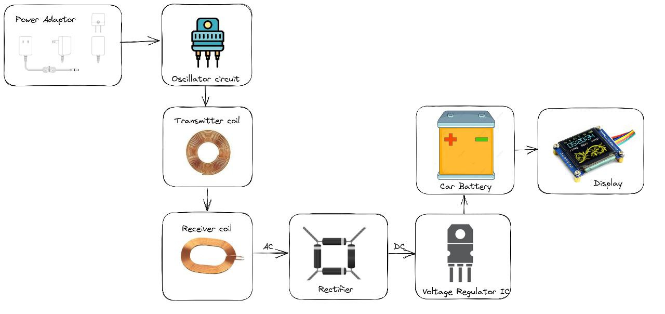
Design Scheme
Block diagram of a wireless power transfer for electric vehicles

Slide 8
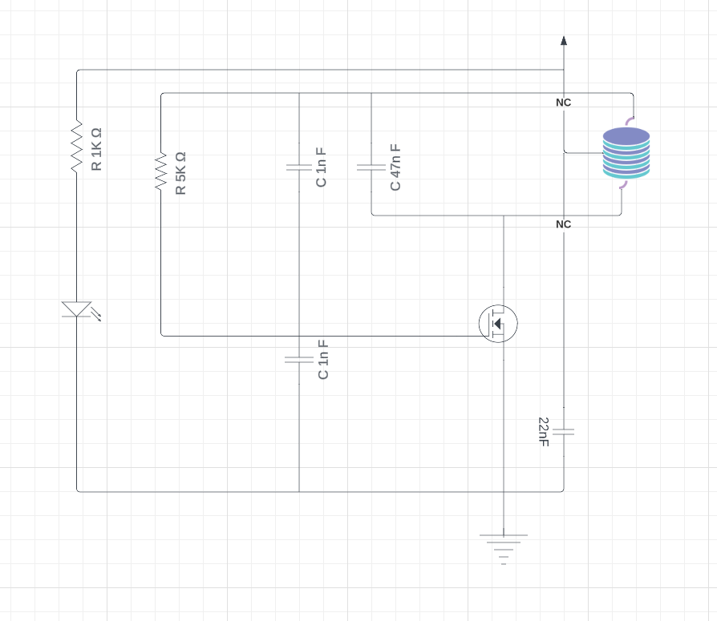
Circuit Diagram : Transmitter
10 Turn
20 AWG
IRFZ44N
Transmitter Part of a wireless power transfer for electric vehicles

Slide 9
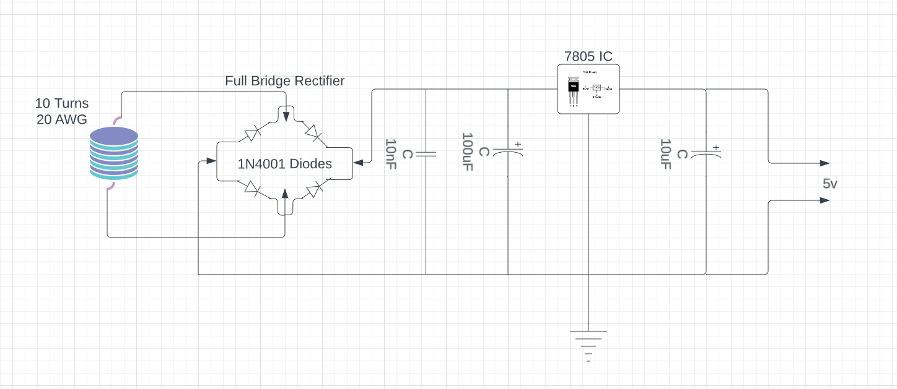
Circuit Diagram : Receiver
Receiver Part of a wireless power transfer for electric vehicles

Slide 10
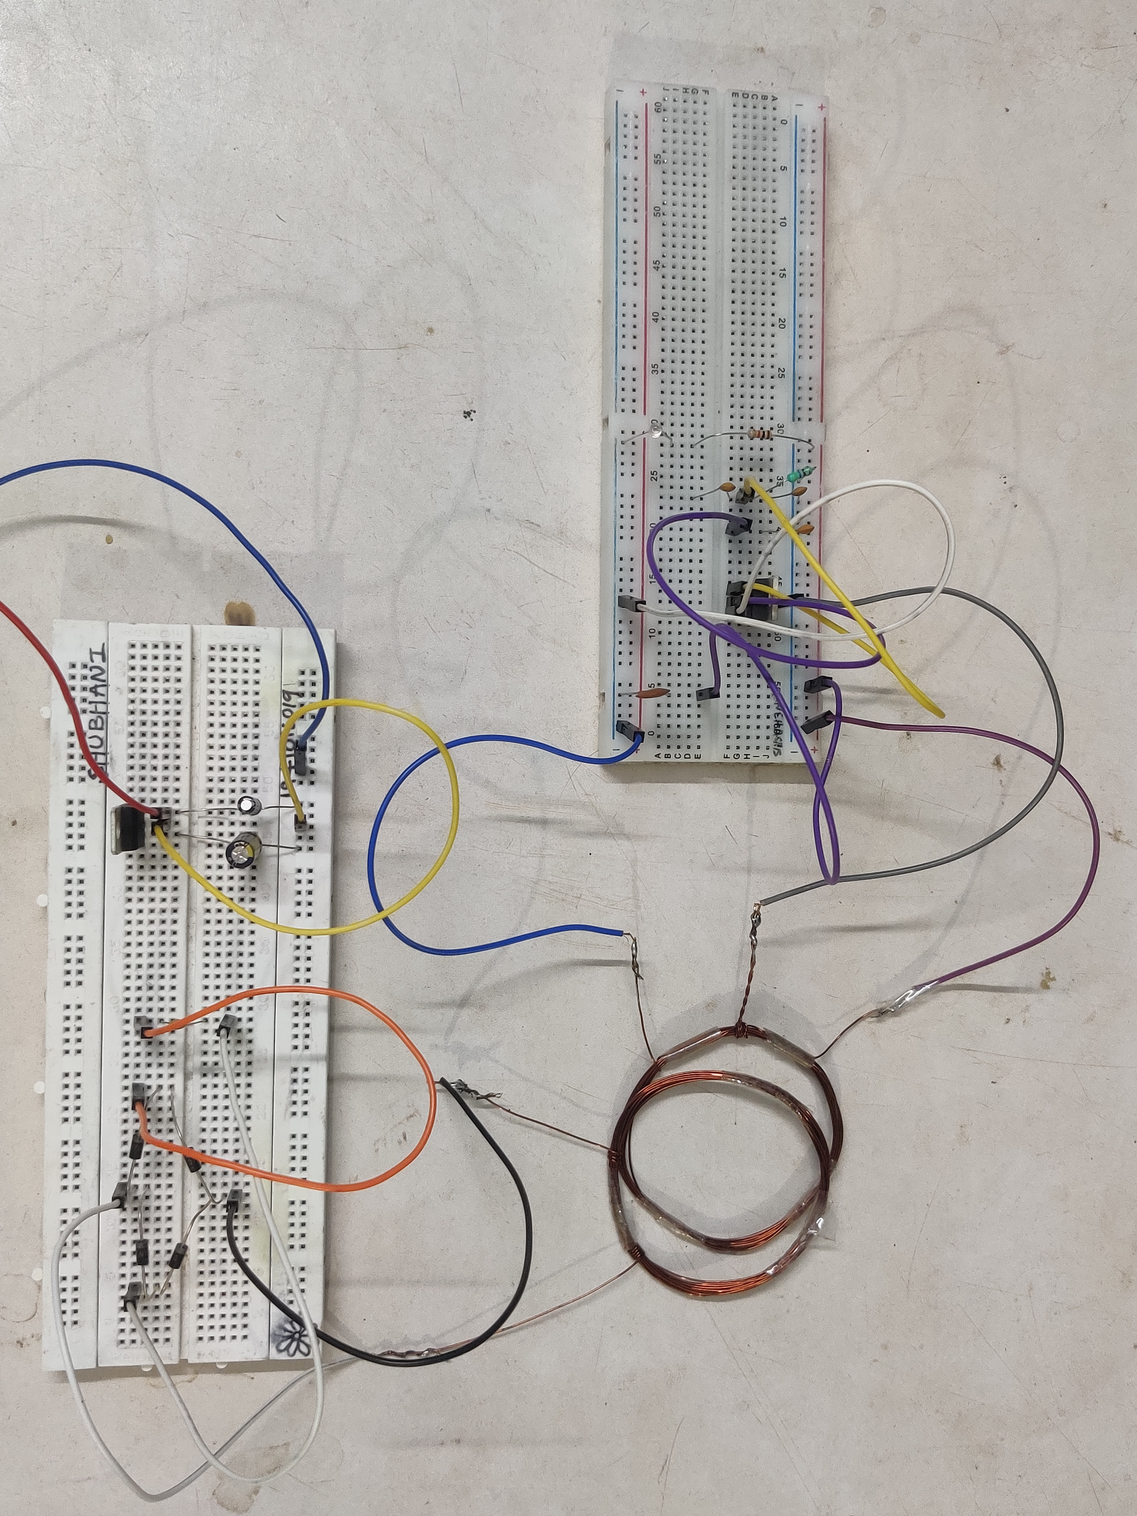
Testing :
The testing results for a wireless power transfer (WPT) system may vary depending on the specific objectives and requirements of the system being evaluated. However, here are some common testing results that are typically assessed:
Power Transfer Efficiency
Distance and Positioning
Temperature and Heat Dissipation

Slide 11
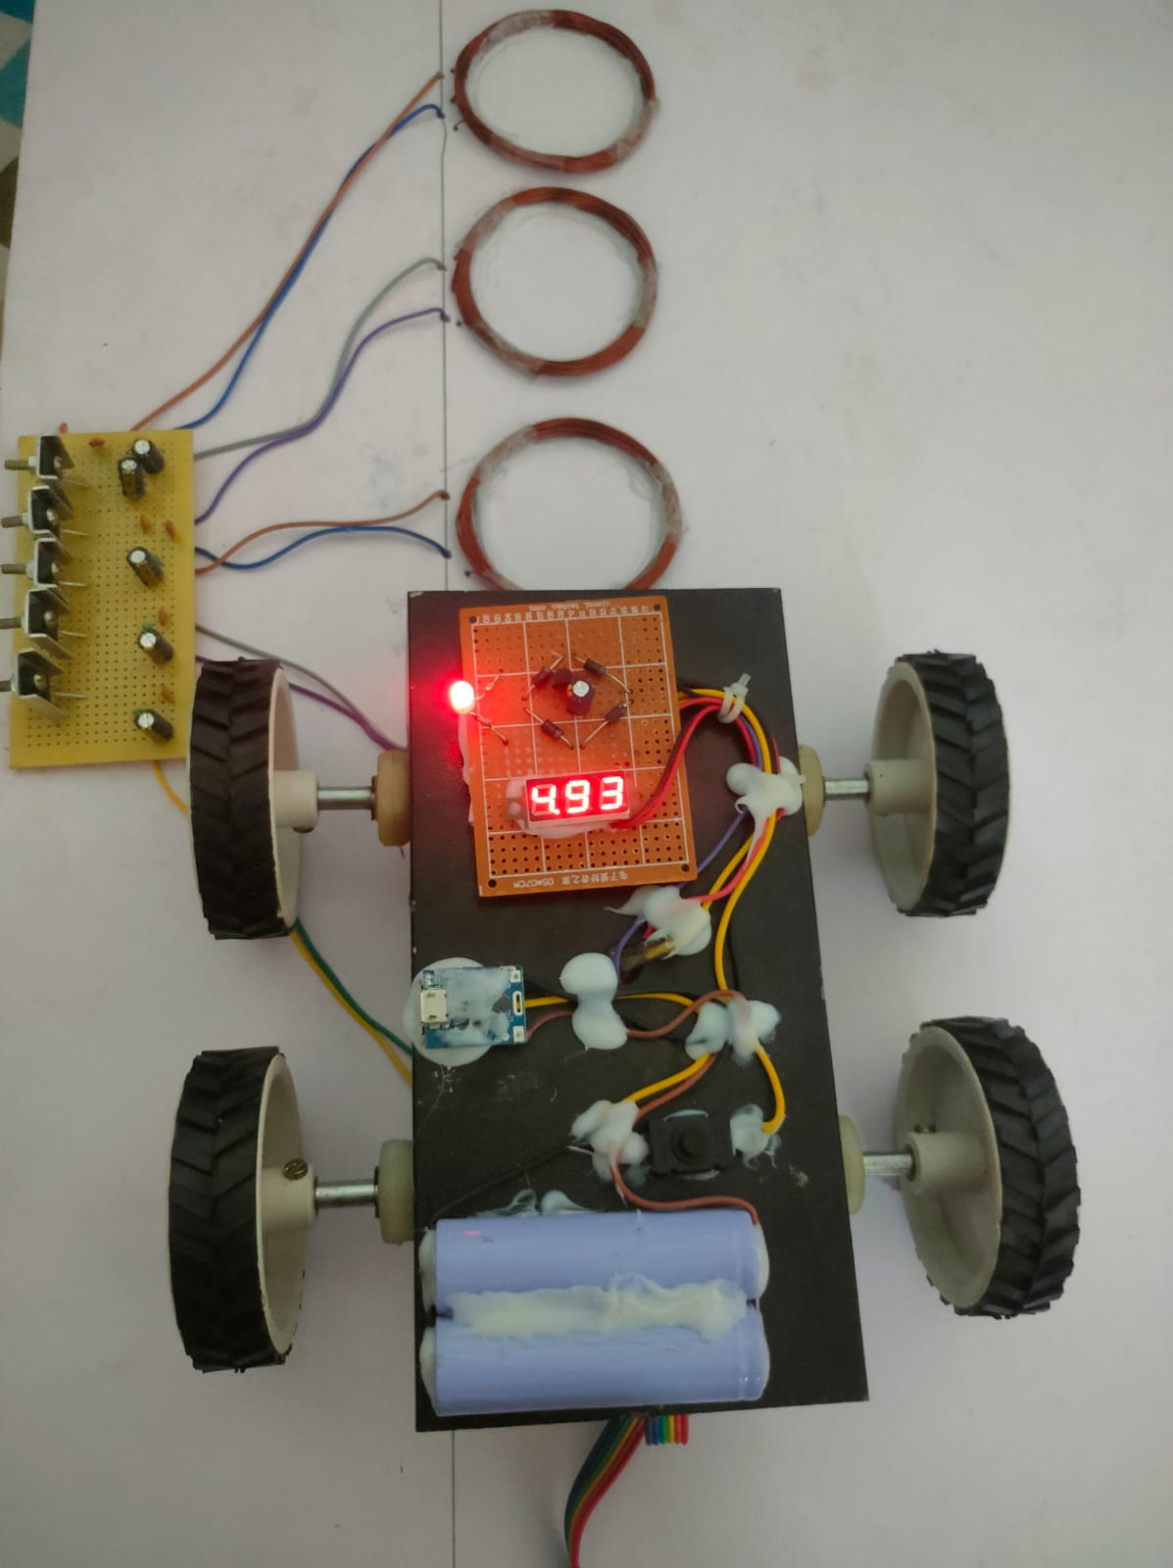
Results, Analysis and Evaluation
Power Transfer Efficiency:
The primary goal of a WPT system is to efficiently transfer power from the transmitter to the receiver.
Testing results shows us the measurements and adding a ferromagnetic material into coil or calculations of power transfer efficiency, indicating how effectively energy is transmitted and received.
Higher efficiency results are desirable, indicating minimal power losses during the transfer process.

Slide 12
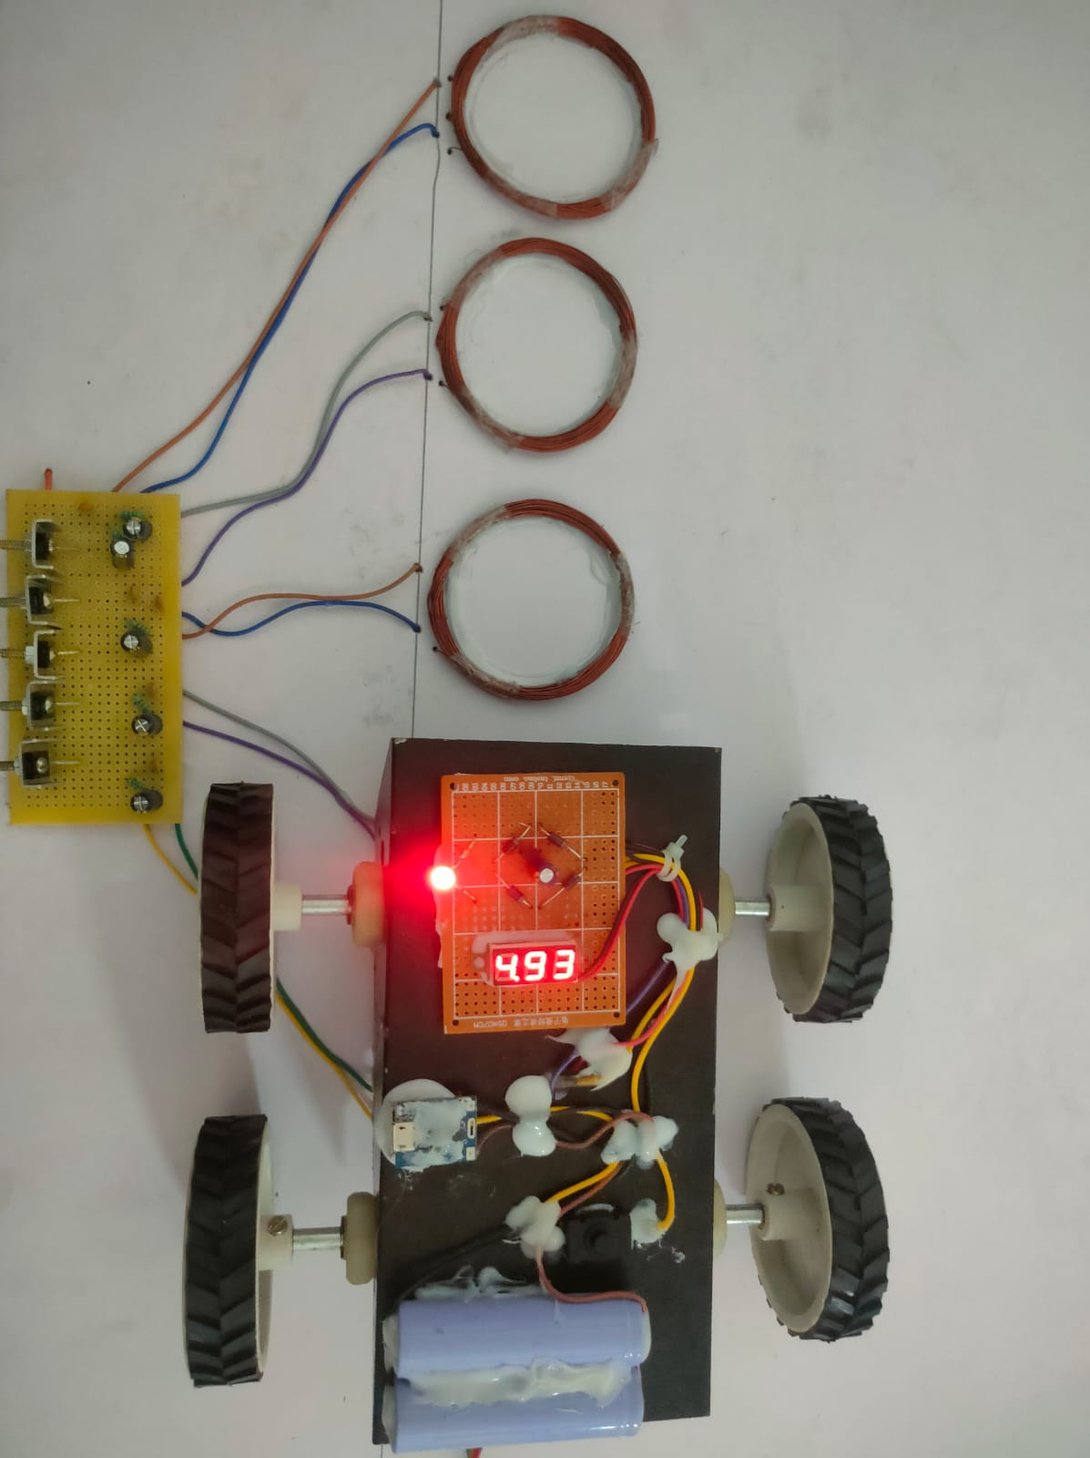
Temperature and Heat Dissipation:
Power transfer can generate heat in the system, which can impact performance and reliability. Testing results should include temperature measurements at different points within the system, assessing heat dissipation capabilities and ensuring that the system operates within safe temperature limits.
Distance and Positioning:
WPT systems often have a maximum distance over which efficient power transfer can occur.
Testing results indicates the distance at which power transfer becomes unreliable or impractical.

Slide 13
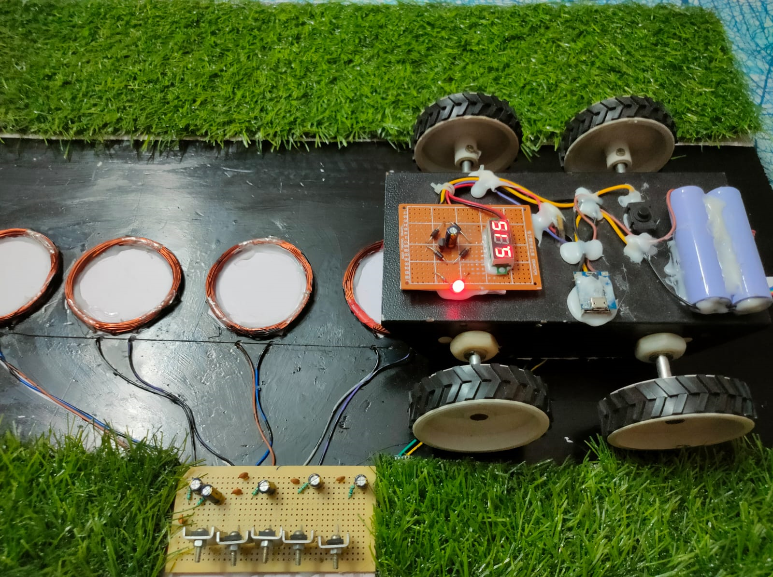
Project Prototype
Our project aims to revolutionize the charging experience for electric vehicles by developing a prototype of a wireless power transmission system, eliminating the need for physical connections and enabling efficient and convenient charging on the go.

Slide 14

Media Clip

Slide 15
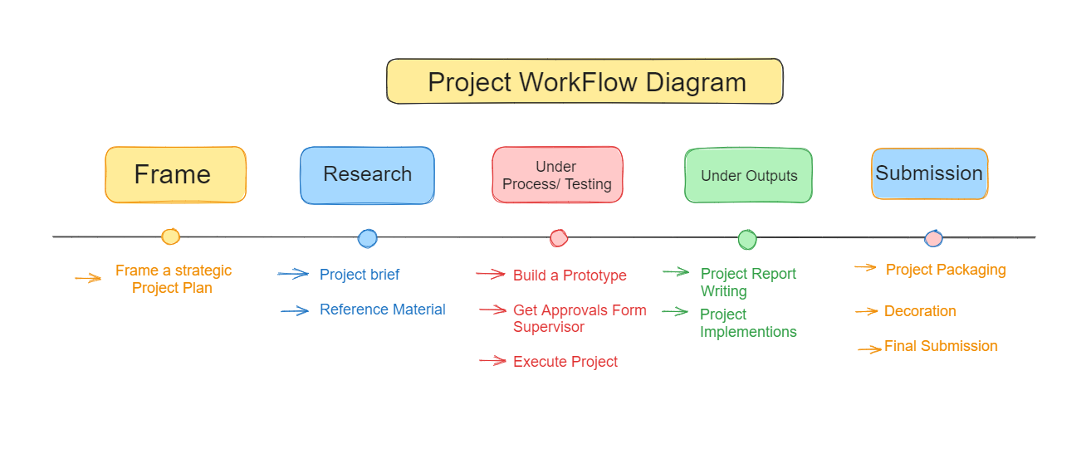
Work Flow

Slide 16
Socio-economic Issues Associated With The Project
Initial installation cost is very high.
Working area is limited.
Heat generation is more than traditional charging.
Copper loss because a large amount of copper wire is required for implementation of Wireless Power Transfer.

Slide 17
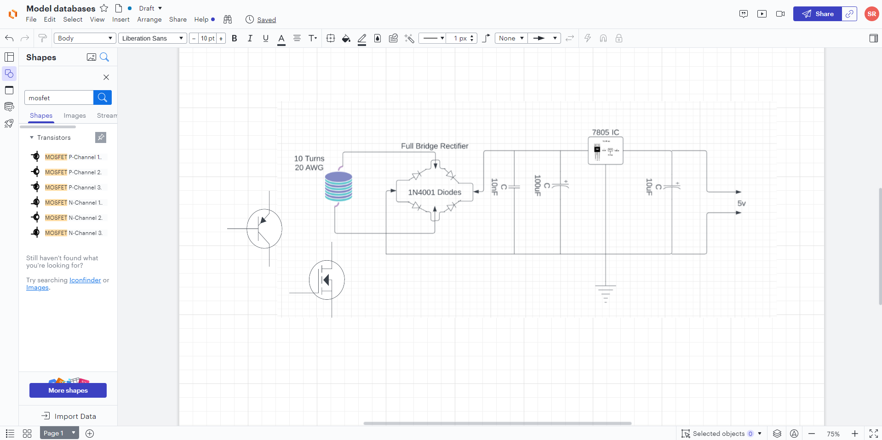
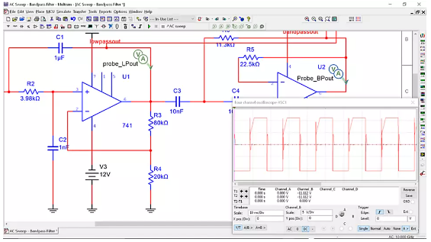
Engineering Tools And Standards
Lucid Chart :
Multisim :
Multisim is industry standard SPICE
simulation and circuit design software for analog,
digital, and power electronics in
education and research.
Lucidchart is your online circuit design software for drawing pictorial and schematic circuit diagrams. Use our circuit symbols and intuitive editor.

Slide 18
Conclusion
wireless power transfer (WPT) systems have emerged as a promising technology with numerous applications and benefits. Throughout this study, we have explored the key aspects and implications of WPT systems. Here are the main conclusions drawn from our analysis:
Efficiency and Convenience: Wireless power transfer offers the convenience of eliminating the need for physical connections between power sources and devices. This technology enables seamless charging of electronic devices.
Scalability and Flexibility: WPT systems can be designed to accommodate various power requirements, ranging from low-power applications to high-power applications.
Future Prospects: The future of wireless power transfer looks promising. As technology continues to evolve, we can expect further advancements in WPT efficiency, extended operating ranges, and integration into a broader range of applications. WPT has the potential to revolutionize various industries, including consumer electronics, transportation, healthcare, and infrastructure.

Slide 19
References
[1] Fisher, Taylor M, et al. "Electric vehicle wireless charging technology: a state-of-the-art review of magnetic coupling systems." Wireless Power Transfer (2014).
[2] Amjad, Muhammad, et al. "Wireless charging systems for electric vehicles.’’ Renewable and Sustainable Energy Reviews (2022)
[3] Li, Yong, et al. "A new coil structure and its optimization design with constant output voltage and constant output current for electric vehicle dynamic wireless charging." IEEE Transactions on Industrial Informatics (2019).
[4] Alhamrouni, Ibrahim, et al. "Application of inductive coupling for wireless power transfer." International Journal of Power Electronics and Drive Systems 11.3 (2020)
[5] Musavi, Fariborz, Murray Edington, and Wilson Eberle. "Wireless power transfer: A survey of EV battery charging technologies." 2012 IEEE Energy Conversion Congress and Exposition (ECCE). IEEE, 2012.
[6] Panchal, Chirag, Sascha Stegen, and Junwei Lu. "Review of static and dynamic wireless electric vehicle charging system." Engineering science and technology, an international journal 21.5 (2018)

Slide 20


Slide 21



